Slide 1

The positive keywords in reviews and the overall rating of products on Amazon
Group 17
Sunwoo Kim
Dongyeon Kang
DS 340W
Final Presentation

Slide 2
Table of Contents
01. Introduction 02. Literature Review
03. Methodology 04. Conclusion & Future Work
05. References

Slide 3
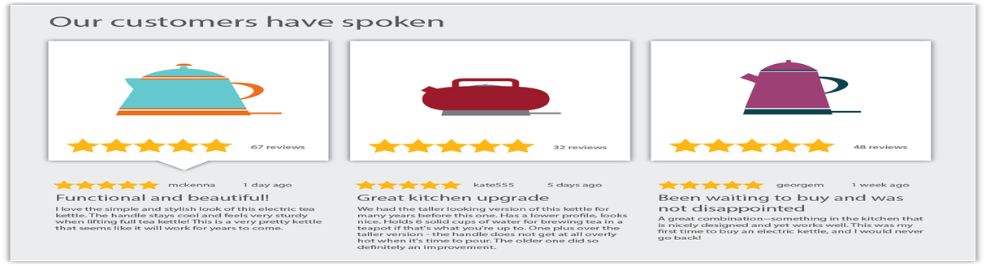
Introduction
Research Question
What is the relationship between the presence of positive keywords in reviews and the overall rating of products on Amazon?

Slide 4
Literature Review
Briefly reviewing three research papers
We were able to…
→ Get some idea to approach to our research question
→ Learned what pros and cons that we could face
→ Realized how to apply to our paper

Slide 5
Research Paper 1
Objective
Investigated the impact of online review keywords on consumer product consideration, especially for clothing, by integrating cue diagnosticity frameworks and product uncertainty theory .
Methodology
Analysis of data from e-commerce platforms and experiments to examine the effects of quality- and fit-related review keywords on consumer decisions .
Key Finding
Quality-related keywords significantly influence product consideration more than fit-related keywords. Further, incorporating social-related and consumer buyback keywords also enhances product consideration.

Slide 6
Research Paper 2
Objective
Focused on extracting and analyzing user sentiment expressions from online reviews to provide attribute-level design feedback and recommendations, enhancing user-centered design processes
Methodology
Employed a rule-based methodology to extract sentiment expressions, utilizing natural language processing techniques to process large volumes of unstructured data from e-commerce platforms
Key Finding
Developed a precise method for extracting sentiment expressions from product reviews, illuminating user preferences and a range of opinions. This enables designers and companies to tailor products and marketing strategies more effectively to user needs

Slide 7
Research Paper 3
Objective
How structural assurance (SA) on e-commerce platforms influences customers' decisions to repurchase, focusing on the interplay between personal experiences and product reviews.
Methodology
Utilizing an experimental setup, the study simulated online shopping scenarios to observe repurchase behavior in environments with varying levels of SA and product quality
Key Finding
Higher SA did not necessarily increase repurchase intentions. Repurchase likelihood was higher on platforms with lower SA; Negative personal experiences had a more significant impact on repurchase decisions than negative reviews.

Slide 8
Methodology
Software & Dataset for the project
Data Preprocessing and Cleaning
Sentiment Scoring with VADER
TF-IDF Weighting and Sentiment Analysis
Correlation Analysis and Visualization

Slide 9

Software & Dataset for the project
Google Colab
The dataset was sourced from Kaggle
The dataset comprises product reviews from Amazon, containing fields such as review text, date of review, product category, customer ratings.
This dataset served as the foundation for our sentiment analysis, allowing us to understand and interpret consumer sentiments and their correlation with product ratings.

Slide 10
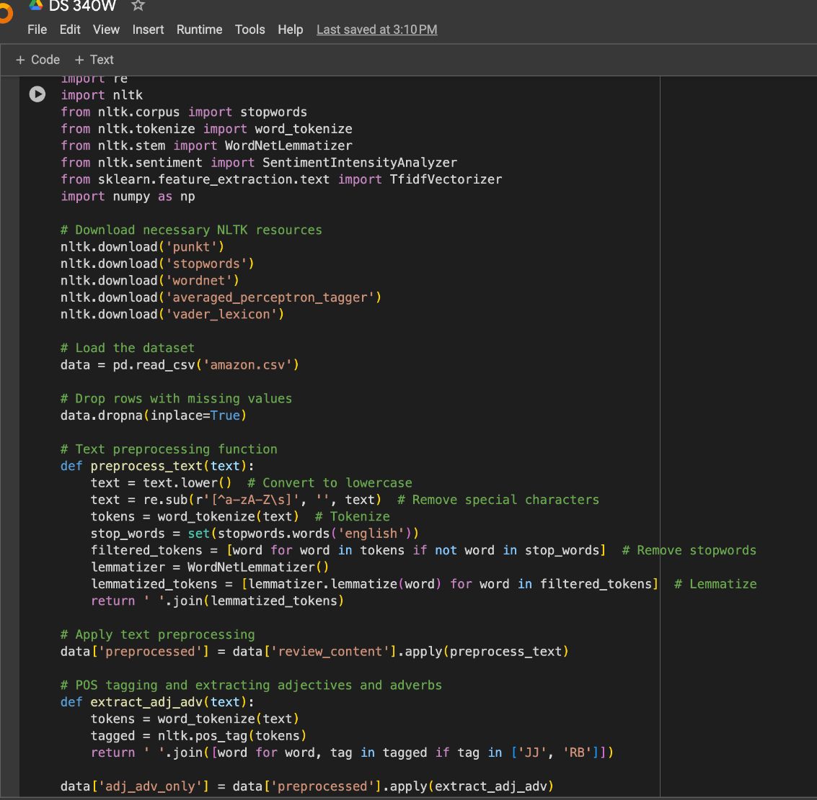
Data Preprocessing and Cleaning
● Text Cleaning
Special characters are removed to declutter the text, focusing analysis on relevant words for sentiment analysis
● Lower Casing
The text is converted to lowercase to ensure uniform processing and to treat the same words consistently, regardless of how they appear in the original text
● Stopword Removal
Common words that typically don't carry sentiment, known as stopwords, are removed to reduce noise and concentrate on the more meaningful sentiment-laden words
● Tokenization and Lemmatization
Text is broken down into individual words through tokenization, and lemmatization is applied to reduce words to their base or root form, aiding in the standardization of the dataset for subsequent analysis.

Slide 11


Slide 12
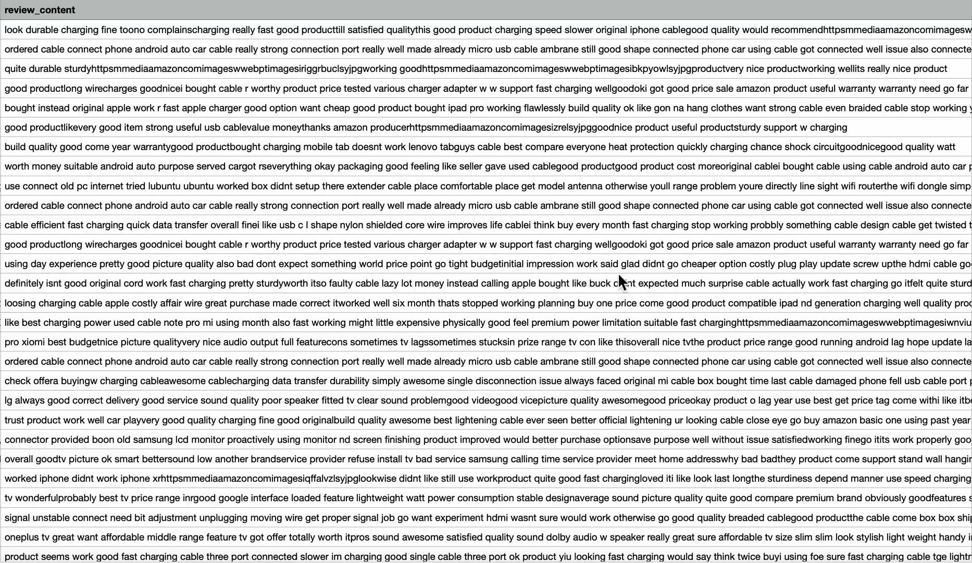

Slide 13
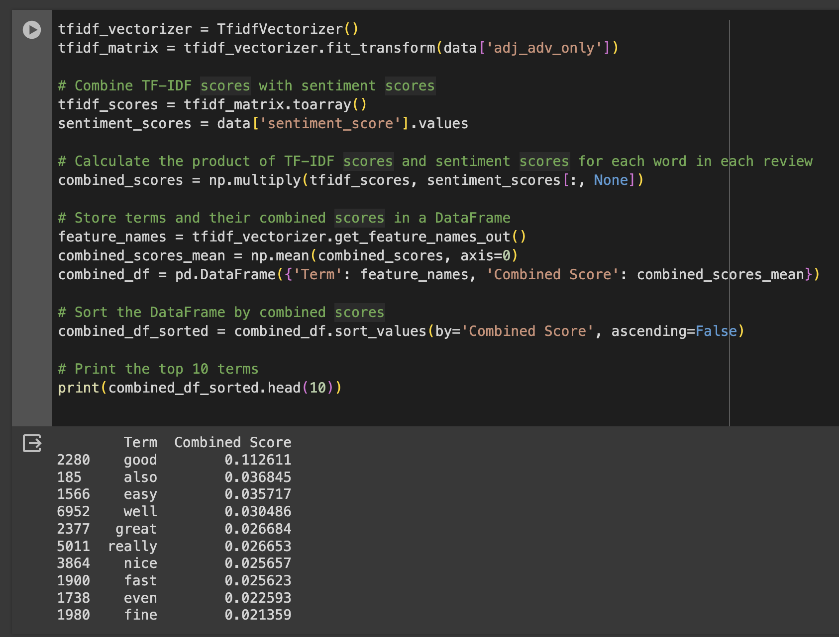
Sentiment Scoring with VADER
Compound Scoring
Utilizes VADER from the NLTK library to assign compound sentiment scores
Quantifies each review’s overall sentiment from highly negative to positive
Emotion Capture
Analyzes the depth of sentiment expressed in reviews
Crucial for evaluating how customer emotions influence product ratings
Contextual Sentiment Analysis
Focuses on adjectives and adverbs to grasp sentiment nuances
Provides deeper insights into the context of expressed sentiments

Slide 14
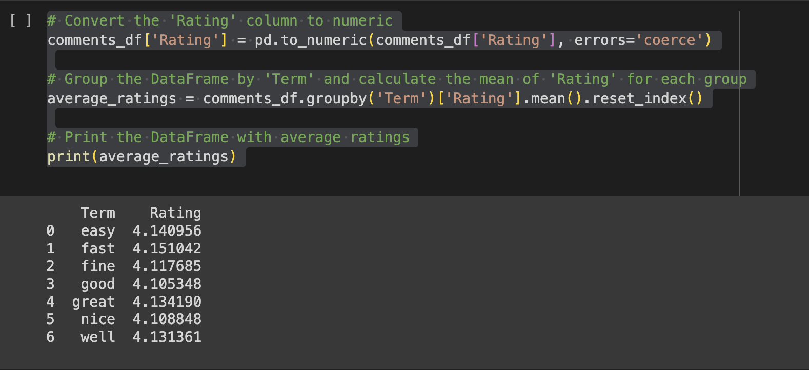
TF-IDF Weighting and Sentiment Analysis
Keyword Importance
Implements TF-IDF to weigh the importance of keywords in reviews, highlighting the significant sentiment indicators within the large datasets
Sentiment Integration
Combines the sentiment scores with TF-IDF weights to ascertain the impact of frequently used sentiment-laden words on the overall sentiment
Insightful Conclusions
This integrated approach is designed to reveal which keywords not only appear frequently but also carry strong sentiment connotations, offering a comprehensive view of how sentiment affects product ratings

Slide 15
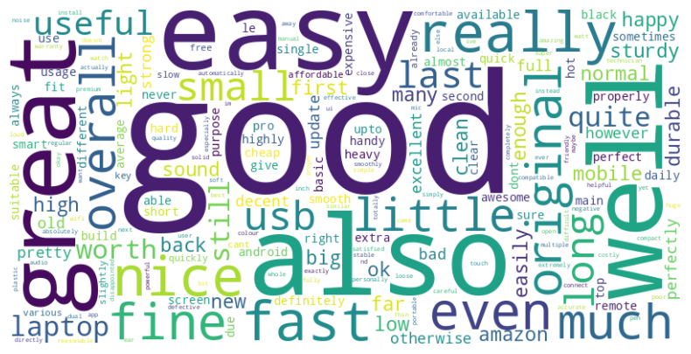
Correlation Analysis and Visualization

Slide 16
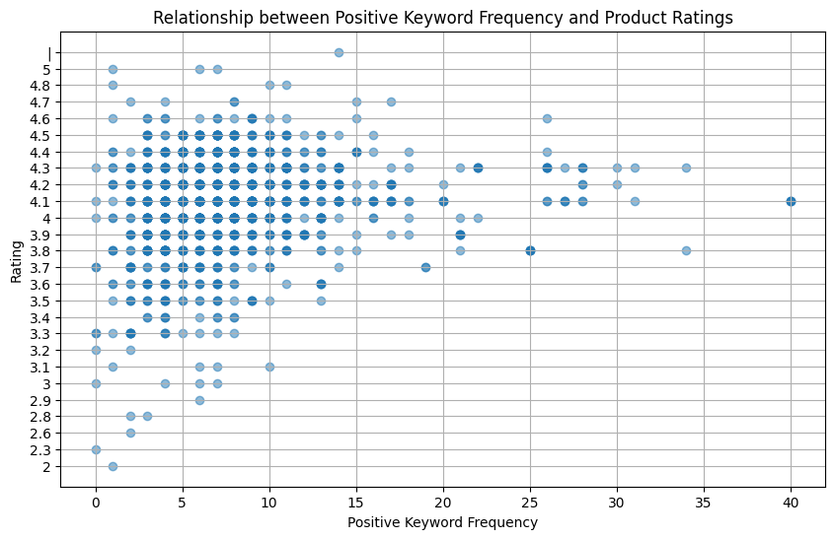

Slide 17
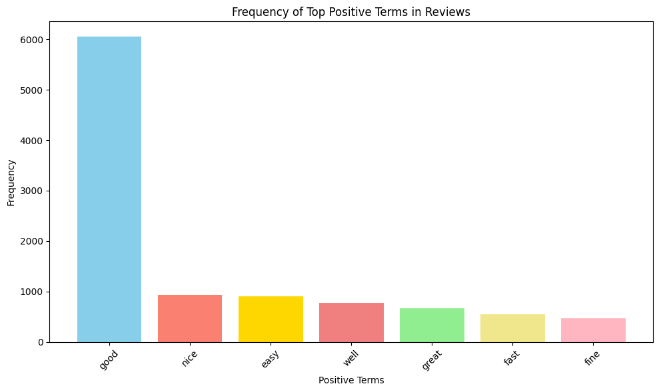

Slide 18
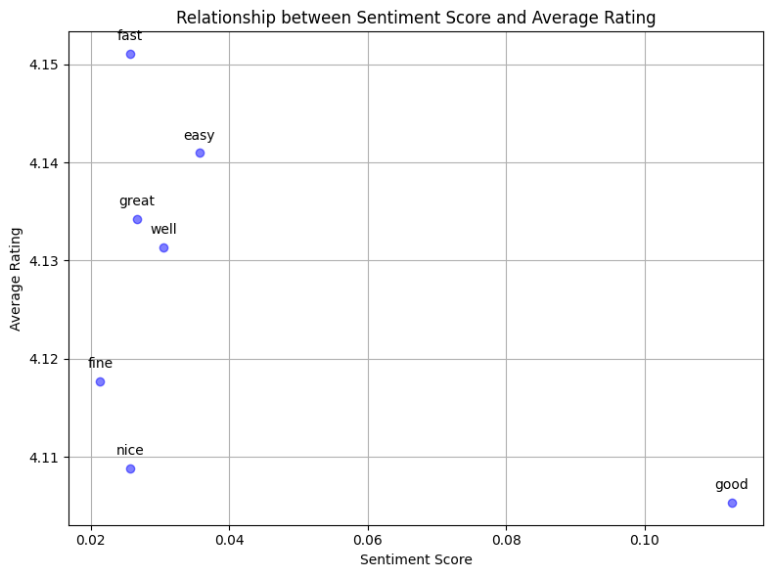

Slide 19
Conclusion
Relationship between positive keywords and product ratings challenged traditional assumptions
Positive language does not consistently correlate with higher ratings
Consumer reviews influenced by external factors beyond positive sentimental terms
Commonly used positive terms may not reliably indicate true customer satisfaction

Slide 20
Future Work
Expand scope to include both positive and negative sentiments
Explore contextual and temporal dynamics of reviews
Employ advanced computational techniques for deeper insights

